Slide 1
Pipelining w/ Google
Markus Winkler
Cloud & DevOps Architect, 10/21/2020

Slide 2
Introduction to Google Cloud Build
Cloud Build use elements
Cloud Source Repository (version control system, ≈ git)
Cloud Build (pipeline) (compiles source code, runs tests, and produces software packages that are ready to deploy, updates the deployment manifests and deploys to GKE)
Container Registry
Google Kubernetes Engine GKE

Slide 3
Project
Everything you do on GCP belongs to a Project
The Project can have multiple pipelines, source repos, clusters, virtual instances

Slide 4
Cloud Build uses
A buildspec is a collection of build commands and related settings, in YAML format, that CodeBuild uses to run a build.
The buildspec is typically named cloudbuild.yaml
The pipeline is run by triggers

Slide 5
steps:
### Build
- id: 'build‘
name: 'gcr.io/cloud-builders/docker‘
entrypoint: 'bash‘
args:
- '-c‘
- |
docker build -t gcr.io/${PROJECT_ID}/${IMAGE_NAME}:${IMAGE_TAG} .
### Publish
- id: 'publish‘
name: 'gcr.io/cloud-builders/docker‘
entrypoint: 'bash‘
args:
- '-c‘
- |
docker push gcr.io/${PROJECT_ID}/${IMAGE_NAME}:${IMAGE_TAG}

Slide 6
Cloud Builders
Container images with common languages and tools installed in them.
You can configure Cloud Build to run a specific command within the context of these builders.
https://cloud.google.com/cloud-build/docs/cloud-builders

Slide 7
Triggers
Trigger do run pipelines
A pipeline can have multiple triggers, e.g. for different stages
Triggers set variables for the pipeline run

Slide 8
Google and Certificates
Google is strict on certificates, fullstop!.
Workarounds which do work in pipelines of AWS or Azure do not work in Google
➔ trusted certificates are mandatory

Slide 9
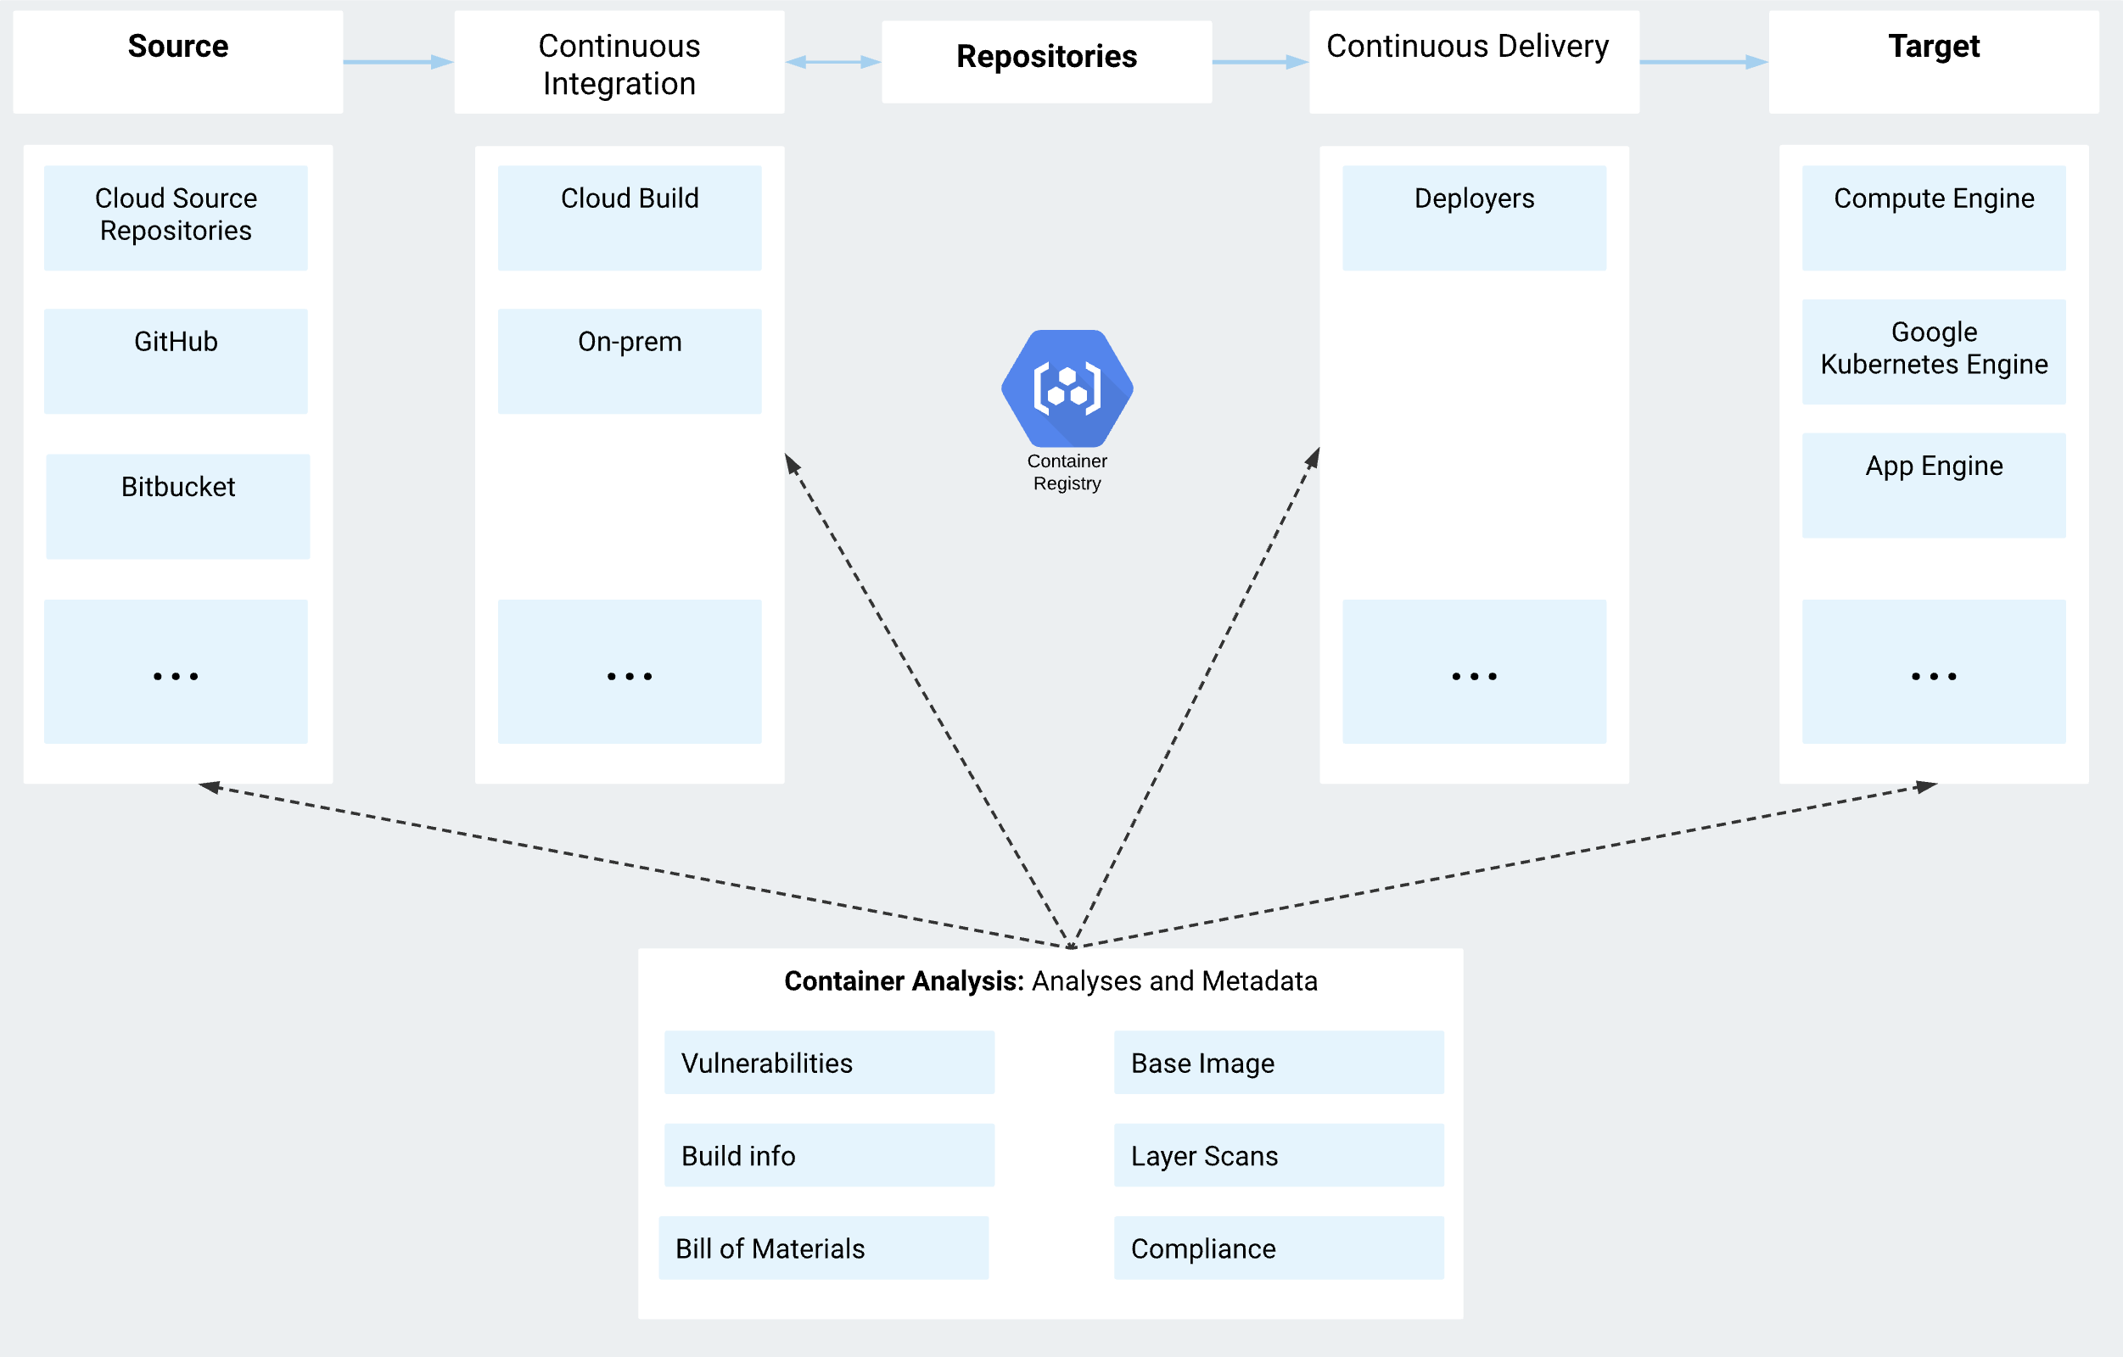
Google Container Registry
Supports Scan
on push and
continuous analysis

